Slide 2
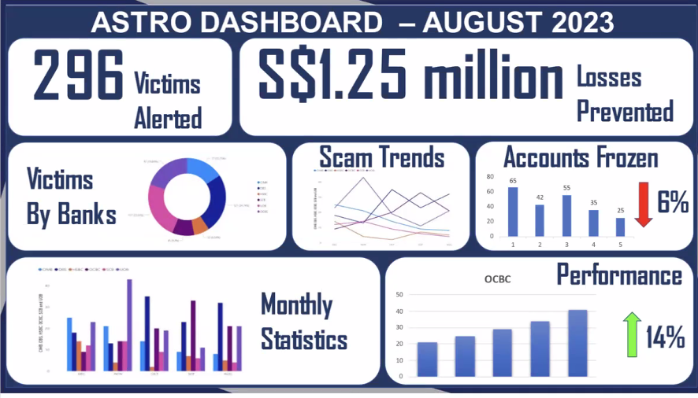
ASC dashboard
Currently in excel in sdrive (ASC to port to MySQL)
8th dashboard is phishpulse

Slide 3
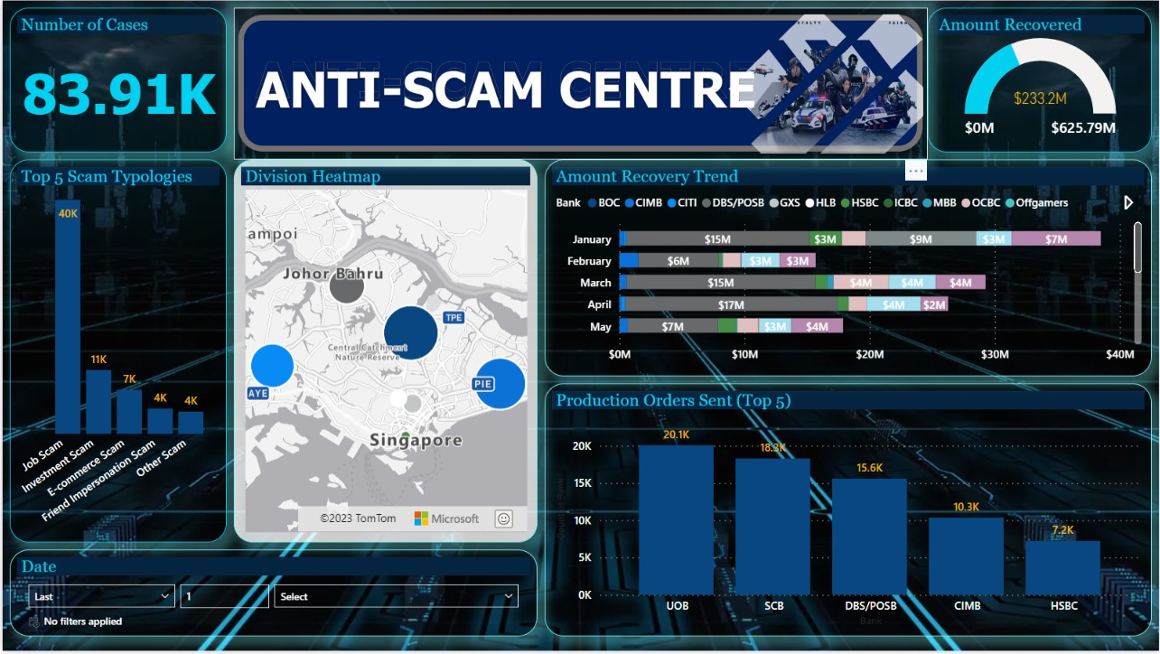
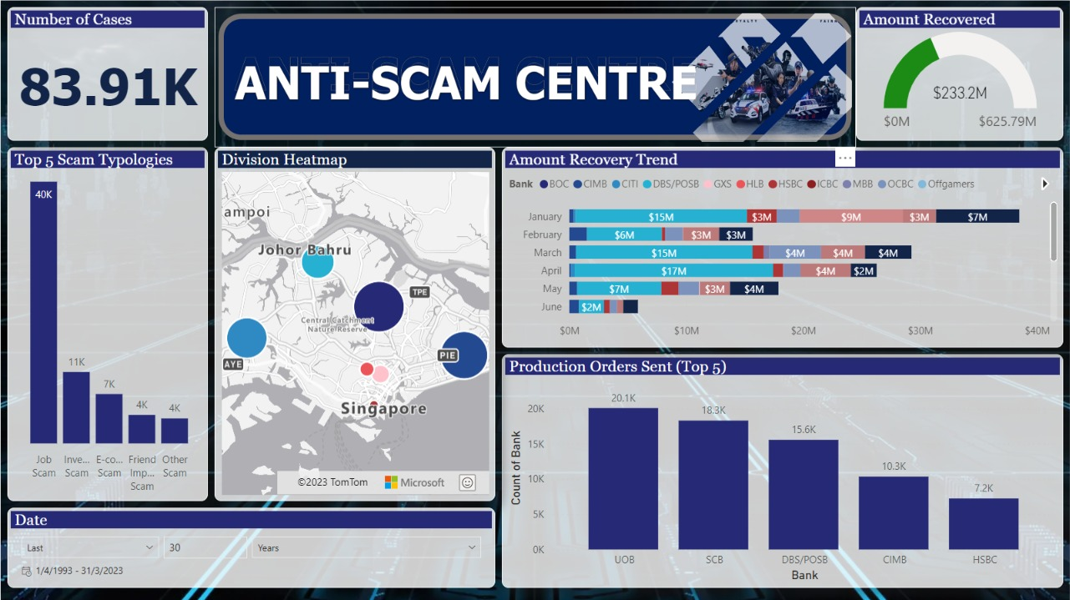
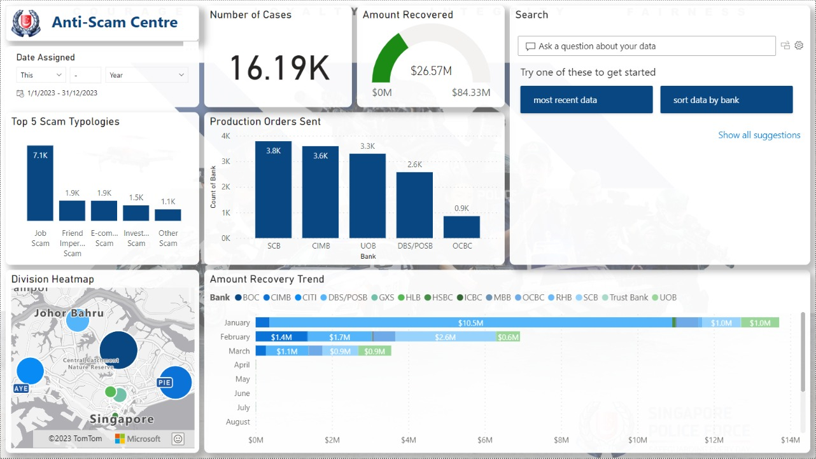
Design 1
Design 2
Design 3

Slide 4
Mysql database login
IP Address: 119.74.24.181
Port: 3306
User: htx
Password: Police123456
Database: astro
SSL: DISABLED

Slide 5
MySql data
Report
report_number char(15)
initial_report_number char(15)
classification text
scam_type text
amount_scammed double
amount_transcated double
remarks text
division_assigned text
date_assigned date
asc_do text
referral_date varchar(255)
division text
Victim
account_holder_name text
account_holder_nric text
acount_holder_phone_number char(8)
Telco
telco_report_number char(15)
overseas_local char(3)
Actions
datetime_production_order_served datetime
datetime_bank_account_frozen datetime
date_bank_details_received date
Scammer
bank text
account_number text
phone_number char(8)
whatsap_number char(8)
online_market_place text
latest_balance_seized double
is_coporate_account tinyint(1)

Slide 6
To do
Input form, data type restricted, with data directly entering mysql. To test on local database so that we don't write into their db.
Filtering based on scam type
Start/end date filtering, on mysql level (before it hits pandas level, so that the runtime is faster I think). Standard set to 1 month away from today's date
Filtering of data from identifiers of primary/secondary keys (https://programmerbay.com/difference-between-primary-key-and-secondary-key/), such as nric/bank account number. Can be a search bar to do the filter. To extend on this, a clickable display of these identifiers based on some filtering (eg. Amount lost)
Logistic regression model to predict upward/downward trend for the next day (see python's scikit-learn logistic regression)

Slide 7
Phishpulse

Slide 8
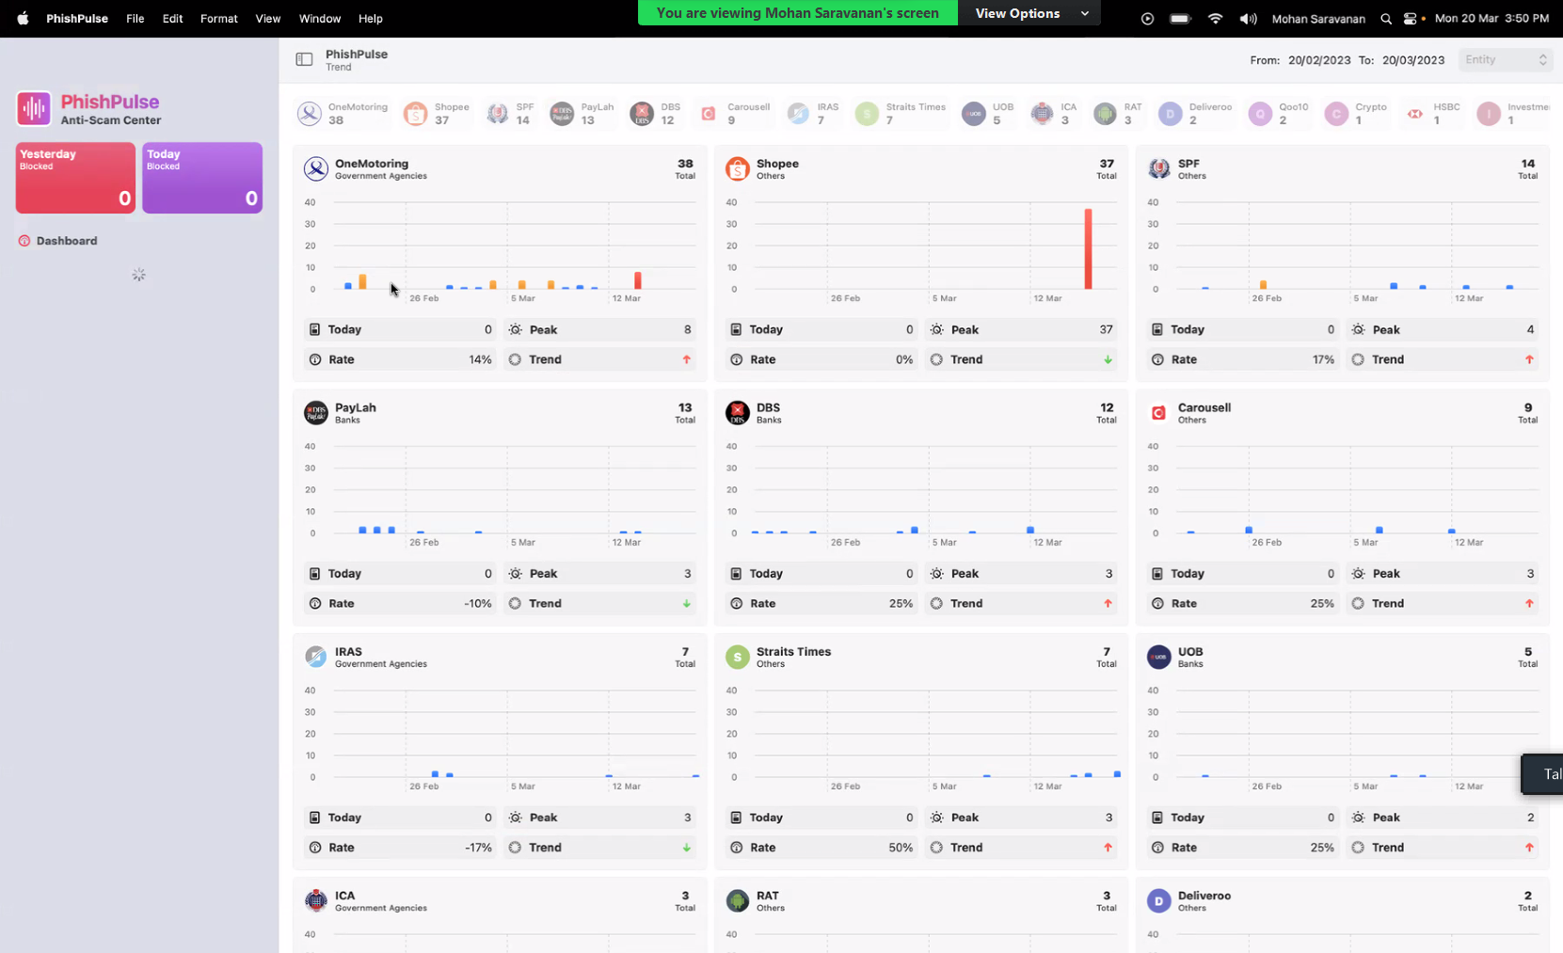
Past 30 days record.
Total number of websites
All stored in mysql
Rate = past certain threshold (e.g. how many days out of 30 days past threshold of 8, e.g. cumulative of past 30 days)
Trend: pass values into linear regression model

Slide 9
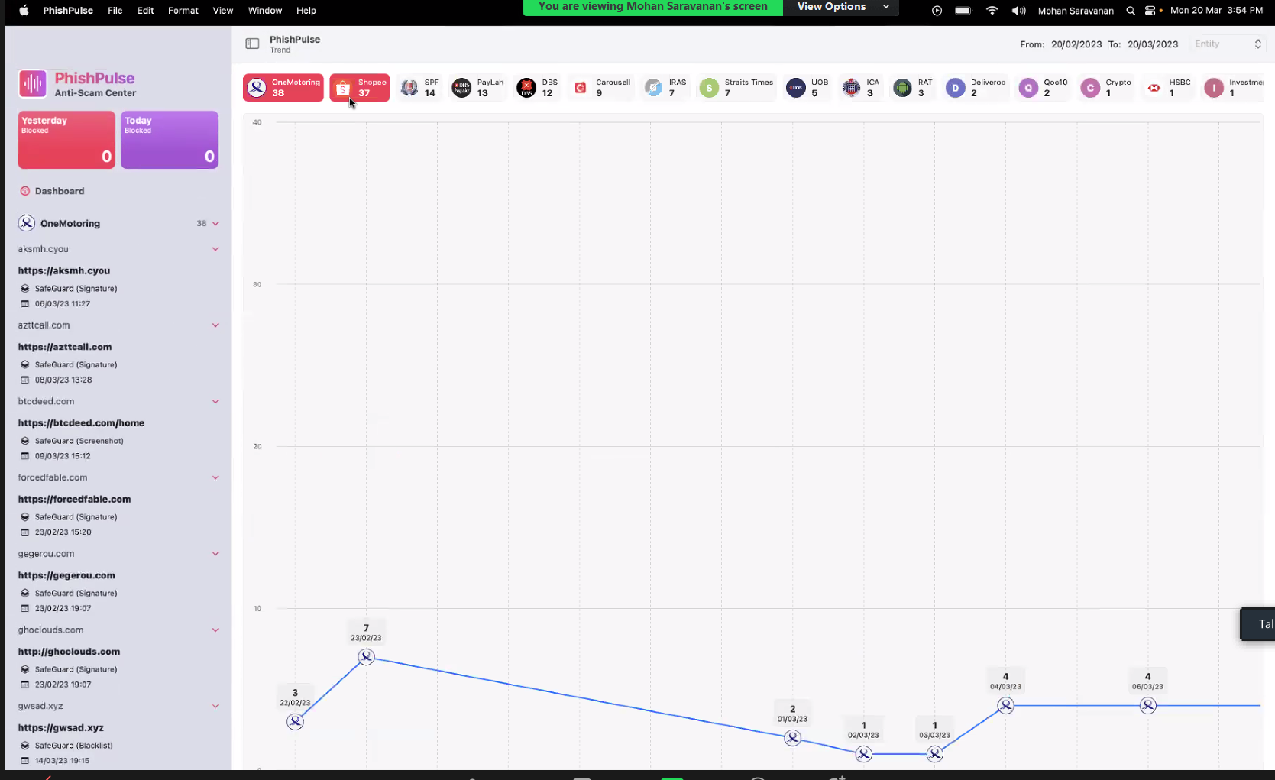

Slide 10
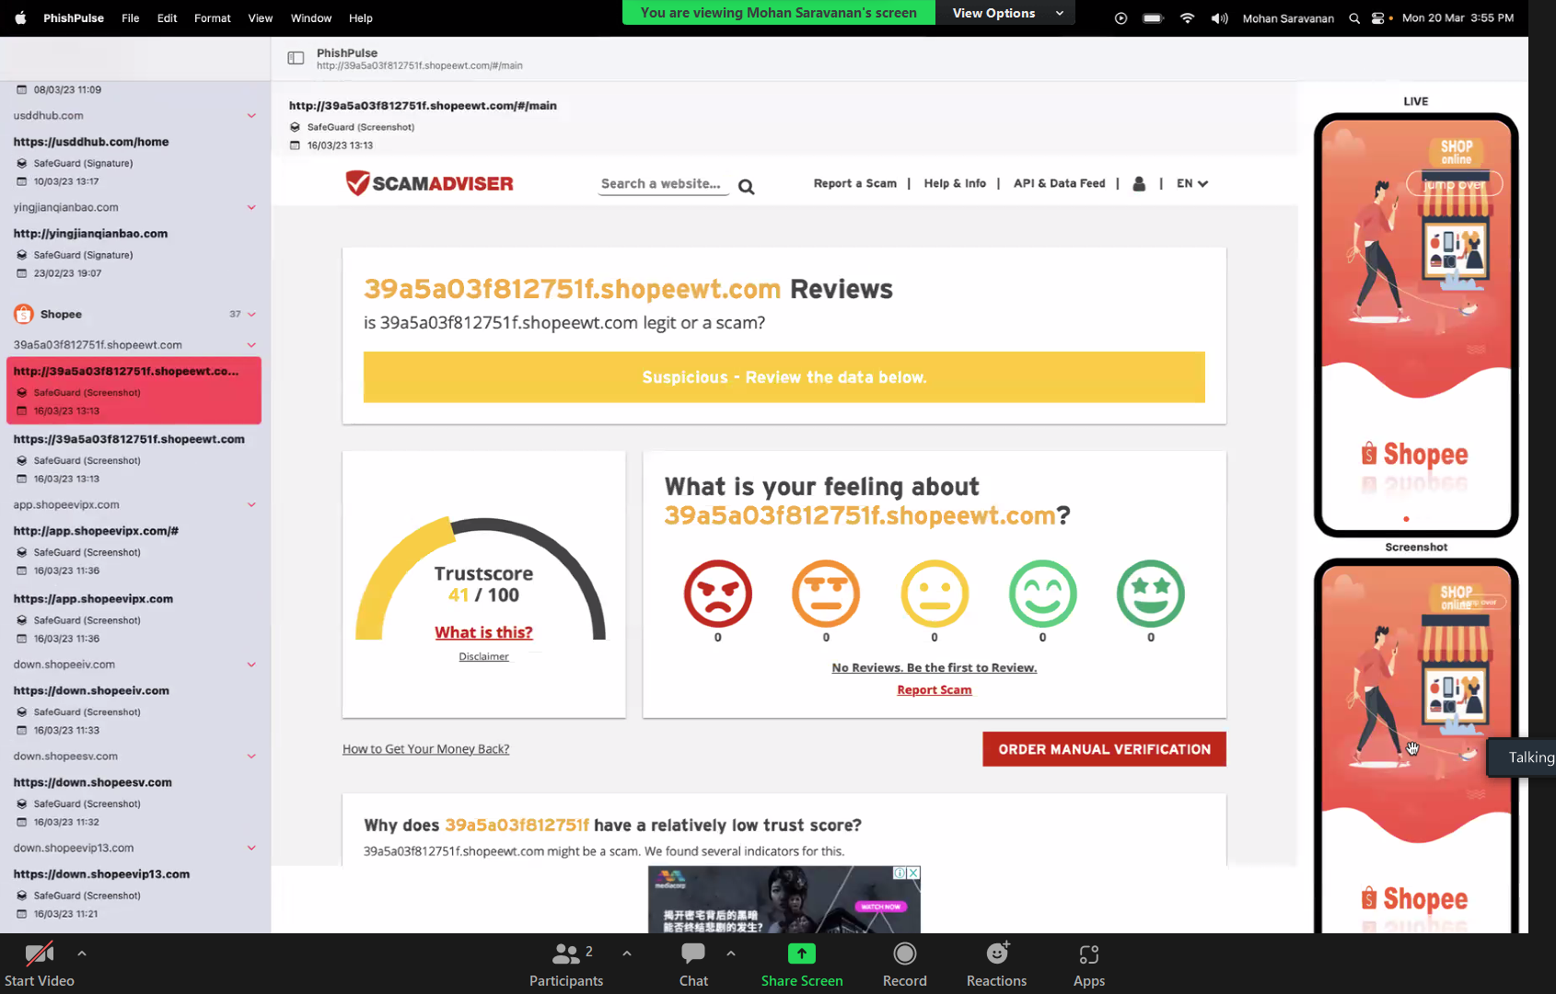
https://api-safeguard.beta.gov.sg/screenshot?api_key=ec16e2d0-1938-49d0-bb0f-a480bc2e8ceb&url_md5=4e332d51fa0c8b94a6b7a9160e10283f

